Slide 1


Subject Name : WIRELESS COMMUNICATION Presentation Title : QPSK IN COMMUNICATION
JEPPIAAR INSTITUTE OF TECHNOLOGY
“Self-Belief | Self Discipline | Self Respect”
Department of Electronics and Communication Engineering
Team Members:
Students Name Reg.No:
1. RAGUL KANNAN.R 210617106064
2. PURUSHOTHAMAN.U 210617106063
3. RAJA ANNAMALAI.P 210617106066
4. REENA GLADIUS.K 210617106069
5. SHALU BHARATHI.S 210617106074
6. VARSHINEY.M 210617106082

Slide 2
Introduction
QPSK is a form of phase modulation technique, in which two information bits are modulated at once, selecting one of the four possible carrier phase shift states.
QPSK-Quadrature Phase-Shift Keying is a system of modulating digital signals onto a radio-frequency carrier signal using four phase 0, 90, 180, 270 degree states to code two digital bits.

Slide 3
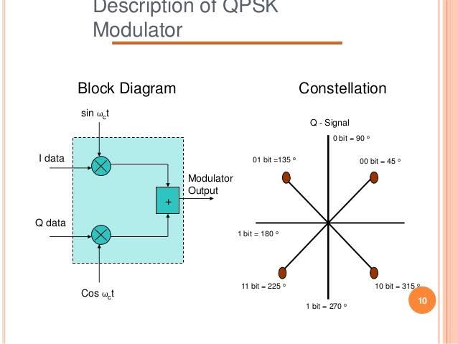
QPSK Modulator

Slide 4
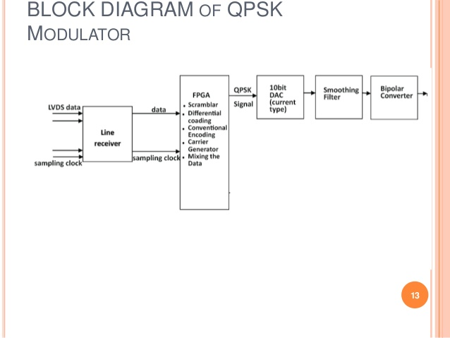
Block Diagram

Slide 5
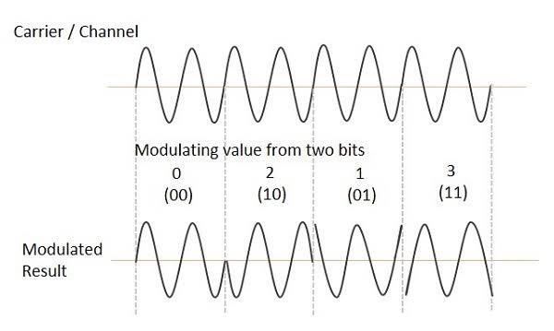
WAVEFORM OF QPSK

Slide 6
Applications Of QPSK
QPSK is used in various cellular wireless standards such as
GSM
CDMA
802.11 WLAN
802.16 fixed and mobile WiMAX
Satellite and Cable TV applications.
As difference between any two constellation point is 90 degree maximum, QPSK modulation type has many benefits.

Slide 7
QPSK provide very good noise immunity It provides low error probability Bandwidth is twice efficient is compared to BPSK modulation For the same BER, the bandwidth required by QPSK is reduced to half as compared to BPSK Carrier power almost remains constant because of QPSK amplitude is not much
Advantages of QPSK

Slide 8
Disadvantages of QPSK
QPSK is not more power efficient modulation technique compare to other modulation types as more power is required to transmit two bits
QPSK is more complex compared to BPSK receiver due to four states needed to recover binary data information

Slide 9
Result & Discussion
Direct Injection locked QPSK modulator is proposed by replacing many blocks in conventional modulator such that mixers, analog-to-digital converters and filters so that area of the proposed modulator is reduced.
Carrier Aggregation is a method that is proposed in LTE-A.

Slide 10
Future Scope
With QPSK, the carrier undergoes four changes in phase (four symbols)and can thus represent 2 binary bits of data per symbol.
A modulation scheme that enables a carrier to transmit 2 bits of information instead of 1..

Slide 11
Reference
https://telecomreseller.com/2012/08/16/quadrature-phase-shift-keying-explained/
https://www.quora.com/What-are-the-future-scope-of-qpsk-modulation-technique

Slide 12
Thank you

